Slide 1

Building Community Online: Small Group Work
Focus on Teaching & Learning 2020
Sandy Helquist
Department of Chemistry & Biochemistry
shelquist@luc.edu

Slide 2
Building Community Intentionally
Focus on Teaching & Learning 2020
Why community?
How to cultivate a sense of belonging?
What modifications to make in course design?
One commonly cited model: ‘Community of Inquiry’ theoretical framework
  Garrison, D.R., Anderson, T., & Archer, W. (2000)
Cognitive Presence
Teaching Presence
Social Presence
LEARNING
EXPERIENCE

Slide 3
Community in Small Groups
Focus on Teaching & Learning 2020
Lessons learned from Spring & Summer 2020
Student 1
Student 2
Student 3
Student 4

Slide 4
Setting Community Norms & Standards
Focus on Teaching & Learning 2020
Leveraging the prior experiences of students
Example: Fall 2015, Chemistry 101 (>90% 1st-year students)
Draft statement: All participants are expected to respect, value, and encourage each others’ contributions in the classroom. This will be done by:
  Participants actively listening to each other’s presentations, questions and answers. Distractions (side conversations, use of personal devices, other) will be kept to a minimum.
  Participants asking questions individually and in groups; participants engaging in problem-solving individually and in groups.
  Correct, incorrect, incomplete and partial answers to questions will be critically but respectfully examined and discussed to cultivate conceptual understanding of material from multiple perspectives.
  Participants will seek to engage with the material by finding areas of personal interest and exploring topics further by asking questions and seeking additional resources for information.

Slide 5
Small Group Norms & Standards Discussion
Focus on Teaching & Learning 2020
What are your goals for this course?
What are the goals for your group?
What does honest collaboration look like for group work?
How can your group help you achieve your goals for this course?
How can you help your group achieve its goals?
How do you want your group members to respond if you are unprepared for a discussion?
What will you do to help your group when you are well-prepared for a discussion?
Is there anything else that is important to discuss with your group?

Slide 6
Building Community in a Remote Learning Environment
Focus on Teaching & Learning 2020
Vinny Donnelly
Quinlan School of Business

Slide 7
Focus on Teaching & Learning 2020
Ice Breakers

Slide 8
Easing Group Contribution
Focus on Teaching & Learning 2020
Ice breakers can be an effective way of starting a training session or team-building event. As interactive and often fun sessions run before the main proceedings, they help people get to know each other and buy into the purpose of the event.
If such a session is well-designed and well-facilitated, it can really help get things off to a great start. By getting to know each other, getting to know the facilitators, and learning about the objectives of the event, people can become more engaged in the proceedings and so contribute more effectively towards a successful outcome.
https://www.mindtools.com/pages/article/newLDR_76.htm

Slide 9
When to Use Icebreakers
Focus on Teaching & Learning 2020
As the name suggests, these sessions are designed to “break the ice” at an event or meeting. The technique is often used when people who do not usually work together, or may not know each other at all, meet for a specific, common purpose.
Consider using an ice breaker when:
Participants come from different backgrounds.
People need to bond quickly so as to work towards a common goal.
Your team is newly formed.
The topics you are discussing are new or unfamiliar to many people involved.
As facilitator you need to get to know participants and have them know you better.
https://www.mindtools.com/pages/article/newLDR_76.htm

Slide 10
Focus on Teaching & Learning 2020
Asynchronous Ice Breakers

Slide 11
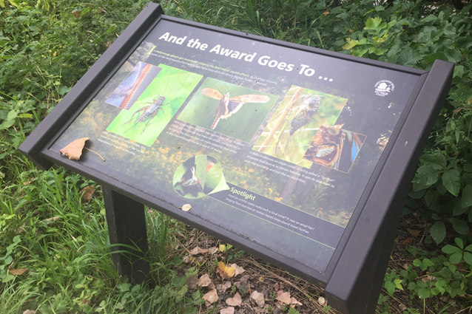
Asynchronous Ice Breaker?
Focus on Teaching & Learning 2020

Slide 12
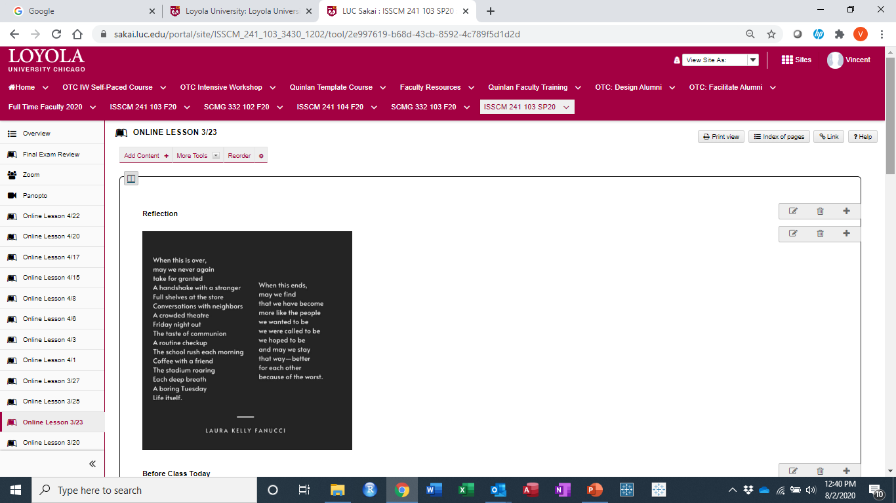
Reflections: Address a Common Experience
Focus on Teaching & Learning 2020

Slide 13

Reflections: Address a Common Experience
Focus on Teaching & Learning 2020

Slide 14
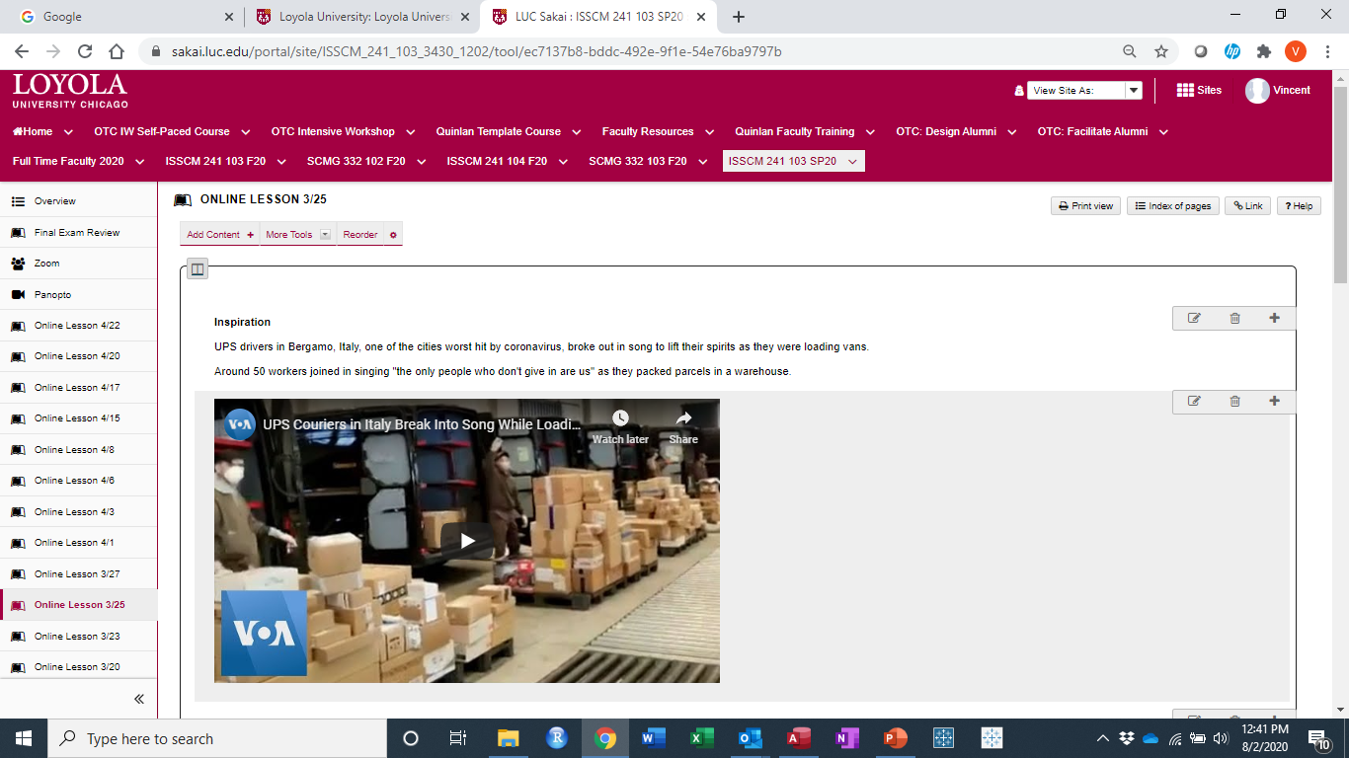
Videos: Bergamo, Italy / Connecting the class experience with the world
Focus on Teaching & Learning 2020

Slide 15
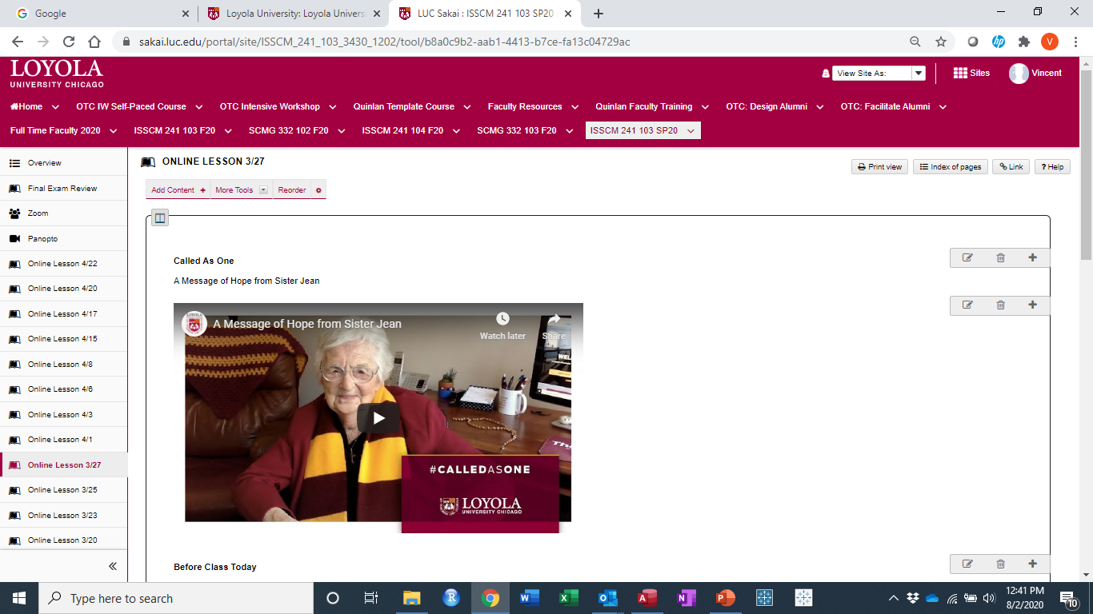
Videos: Sister Jean’s Message of Hope
Focus on Teaching & Learning 2020

Slide 16

Levity: Using humor to connect to the Chicago community
Focus on Teaching & Learning 2020

Slide 17
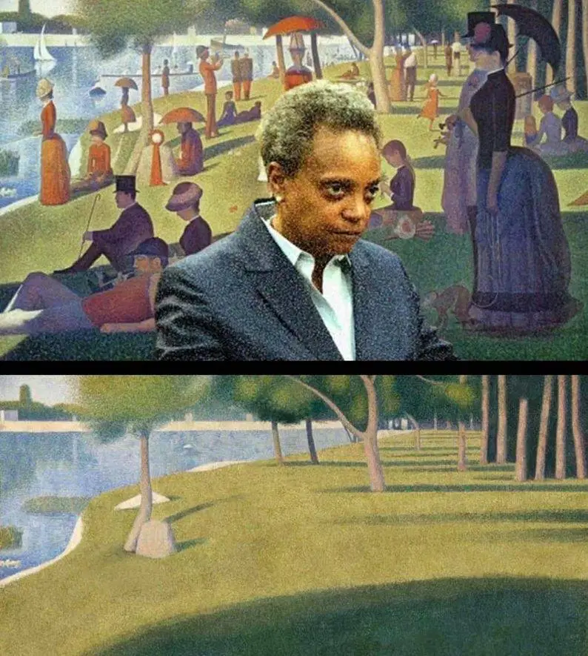
Levity: Using humor to connect to the Chicago community
Focus on Teaching & Learning 2020

Slide 18
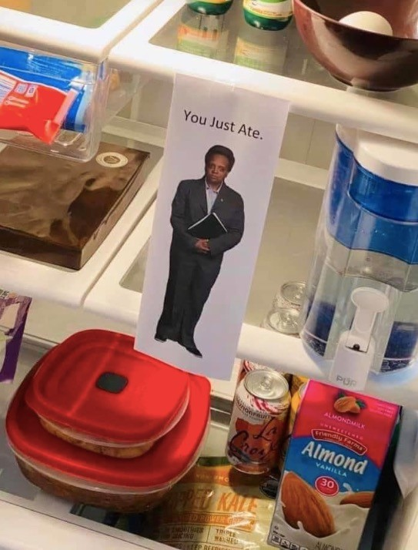
Levity: Using humor to connect to the Chicago community
Focus on Teaching & Learning 2020

Slide 19
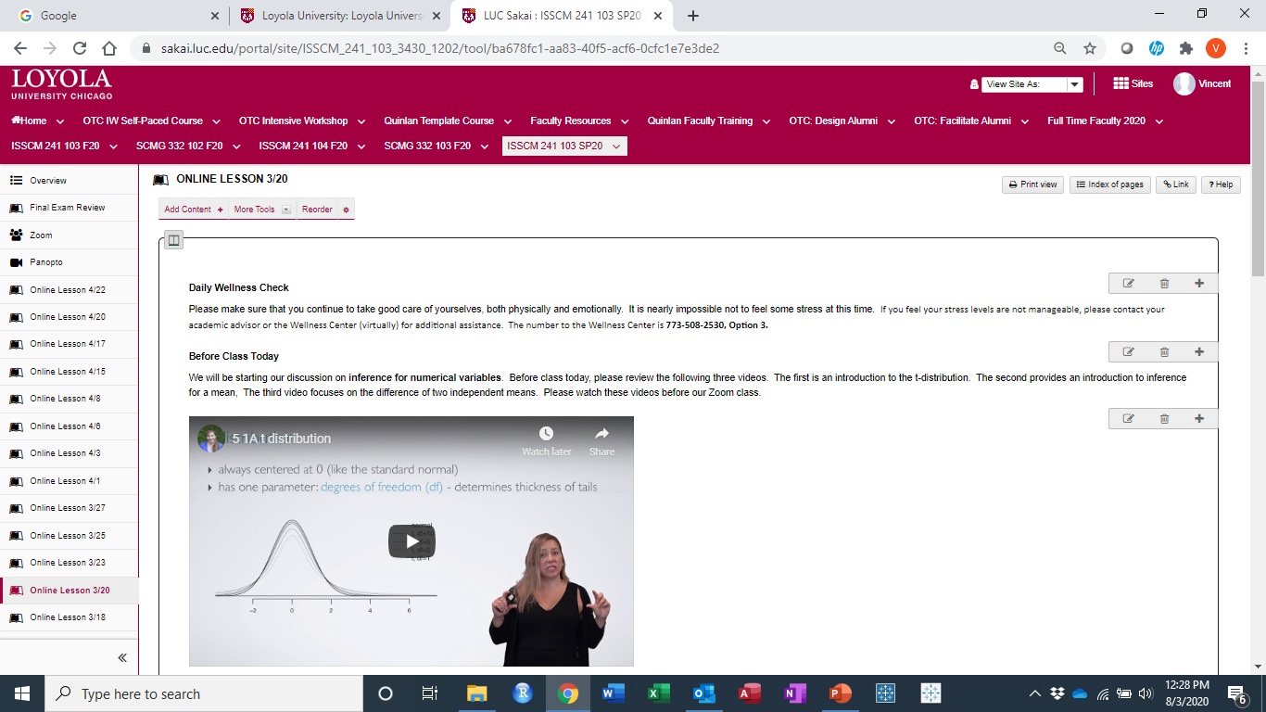

Slide 20
Wellness Check
Focus on Teaching & Learning 2020
Please make sure that you continue to take good care of yourselves, both physically and emotionally. It is nearly impossible not to feel some stress at this time.
If you feel your stress levels are not manageable, please contact your academic advisor or the Wellness Center (virtually) for additional assistance.
The number to the Wellness Center is 773-508-2530, Option 3.

Slide 21
Asynchronous Ice Breakers
Focus on Teaching & Learning 2020
Use empathy to connect to the current communal situation
Inject humor to keep students engaged
Provide an outlet for critical messaging

Slide 22
Focus on Teaching & Learning 2020
Synchronous Ice Breakers

Slide 23
Introductory Ice Breakers
Focus on Teaching & Learning 2020
These are used to introduce participants to each other and to facilitate conversation amongst them.
The Little Known Fact:
Ask participants to share their name, department or role in the organization, length of service, and one little known fact about themselves. This “little known fact” becomes a humanizing element that can help break down differences such as grade/status in future interaction.
True or False:
Ask your participants to introduce themselves and make three or four statements about themselves, one of which is false. Now get the rest of the group to vote on which fact is false. As well as getting to know each other as individuals, this exercise helps to start interaction within the group.
https://www.mindtools.com/pages/article/newLDR_76.htm

Slide 24
Introductory Ice Breakers
Focus on Teaching & Learning 2020
These are used to introduce participants to each other and to facilitate conversation amongst them.
Interviews:
Ask participants to get into twos. Each person then interviews his or her partner for a set time while paired up. When the group reconvenes, each person introduces their interviewee to the rest of the group.
Problem Solvers:
Ask participants to work in small groups. Create a simple problem scenario for them to work on in a short time. Once the group has analyzed the problem and prepared their feedback, ask each group, in turn, to present their analysis and solutions to the wider group.
https://www.mindtools.com/pages/article/newLDR_76.htm

Slide 25
Focus on Teaching & Learning 2020
Data Labs

Slide 26
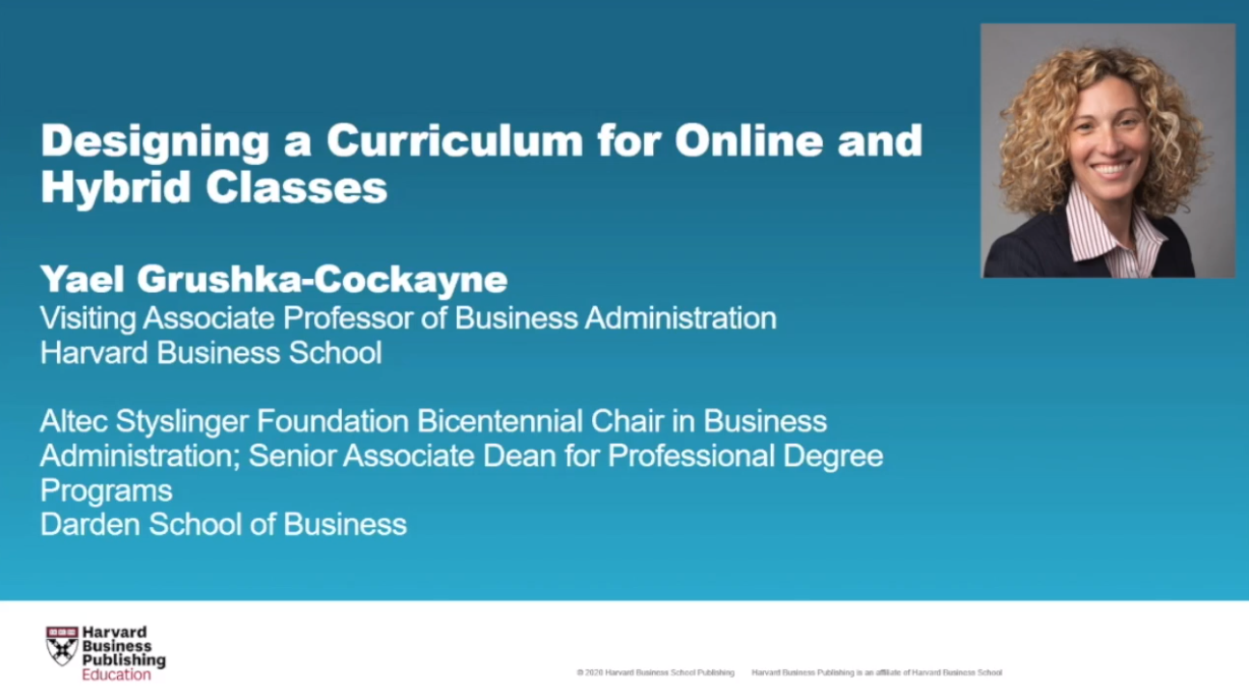

Slide 27
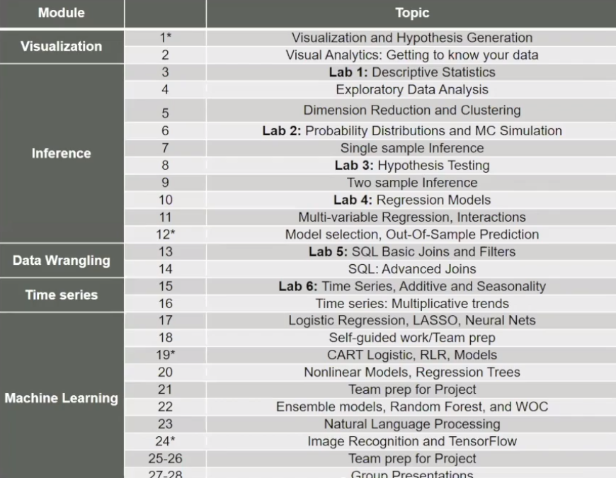

Slide 28
Lab Execution
Focus on Teaching & Learning 2020
Learning and Assessment Process
Walk through the lab in Zoom during class period
Provide step-by-step worksheet and data sets
Students are required to answer basic questions from their analysis
Students submit answers in Sakai Quizzes
Building Community Component
Students can gain extra points by being a “peer learner”
These students are made available for other students to contact to help them with the labs
Every student must still submit answers in Sakai

Slide 29
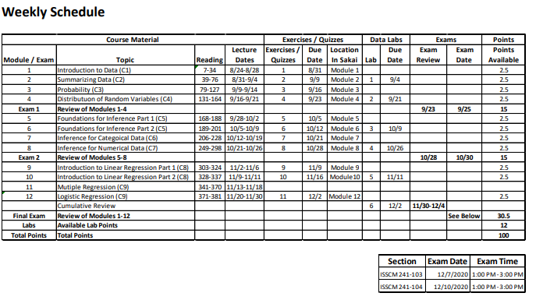

Slide 30
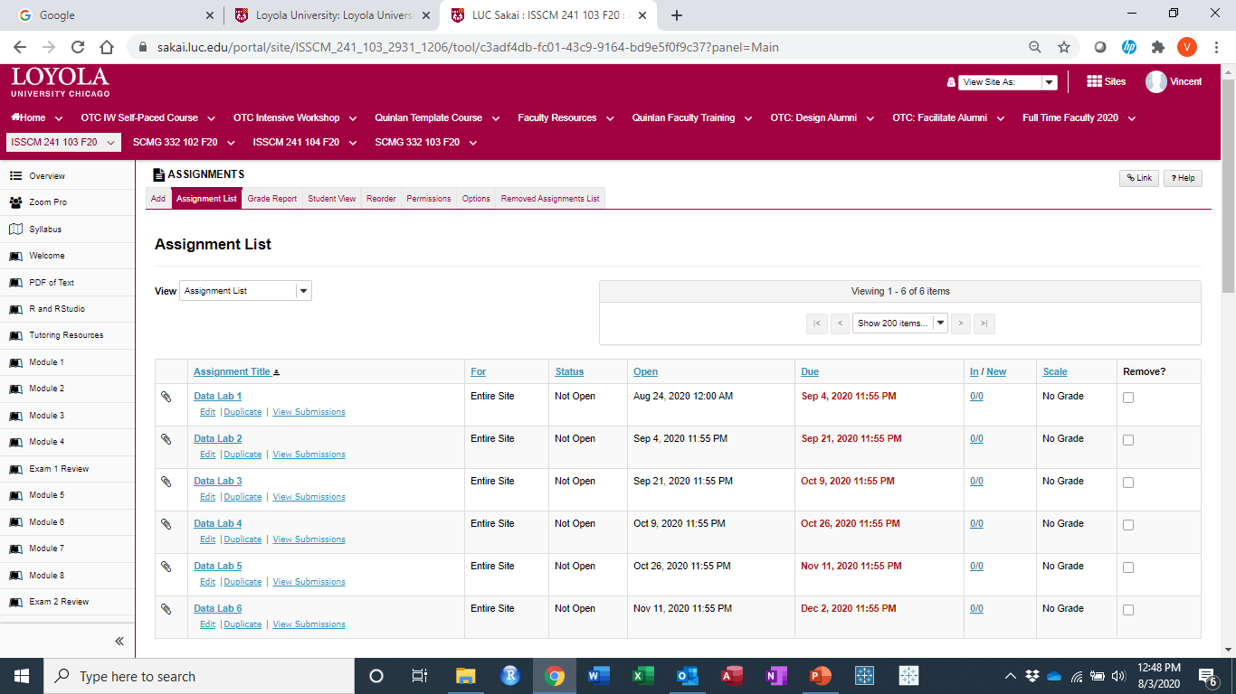
Data Labs: Built as assignments in Sakai
Focus on Teaching & Learning 2020

Slide 31
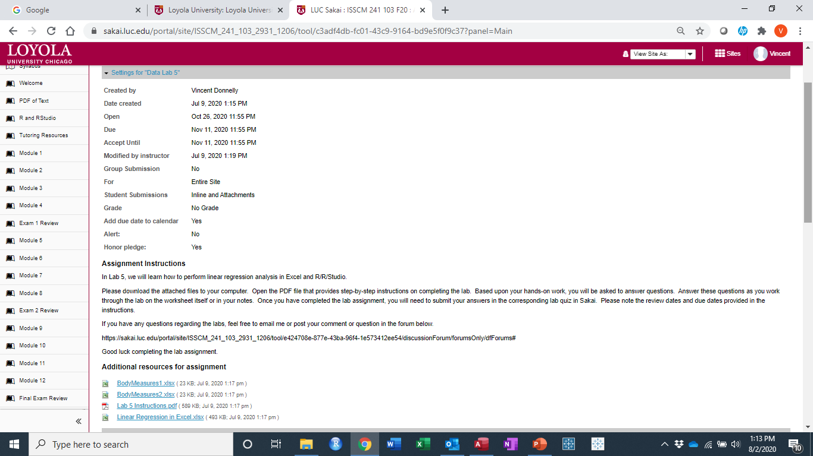
Data Labs: Built as assignments in Sakai
Focus on Teaching & Learning 2020

Slide 32
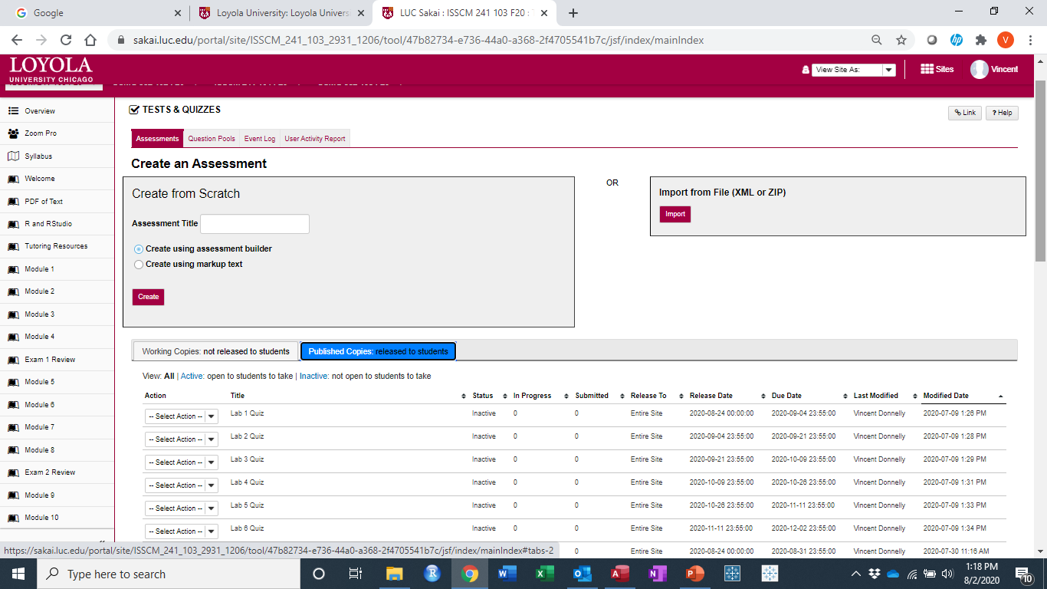
Data Labs: Access completion and accuracy in Sakai Quizzes
Focus on Teaching & Learning 2020

Slide 33
Focus on Teaching & Learning 2020
Questions?

Slide 34
Online Community Building through the Study of Chicago Hip Hop Culture Communication Asset Mapping
Focus on Teaching & Learning 2020
George Villanueva, Ph.D.
Assistant Professor of Advocacy & Social Change
School of Communication

Slide 35
Objectives
Focus on Teaching & Learning 2020
Reimagining classrooms as cyphers
‘Communication Asset Mapping’ Hip Hop Culture Community Building in Chicago
Crew Formations & Assigned Field Sites
Adjusting to Online Community Fieldwork
Implications on Community Building

Slide 36

Reimagining the classroom as a ‘cypher’ to build community
Focus on Teaching & Learning 2020
“Historically the cypher was the place within Hip Hop culture where emcees would get together in a circle and initiate a ‘freestyle’ construction of rhymes. What we have achieved in this project is a freestyle construction of knowledge about the culture that is lived and loved (Williams 2009, p. 8)”

Slide 37
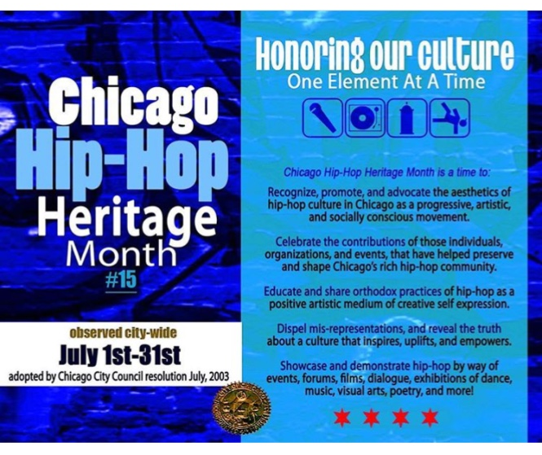
‘Communication Asset Mapping’ Hip Hop Culture
Community Building in Chicago
Focus on Teaching & Learning 2020
“Communication asset mapping” (CAM) is a field mapping exercise which requires you to go out into the neighborhood or physical location to map aspects of the urban environment that communicate community strengths, building, and a potential for positive social change (Villanueva, et al. 2016).

Slide 38
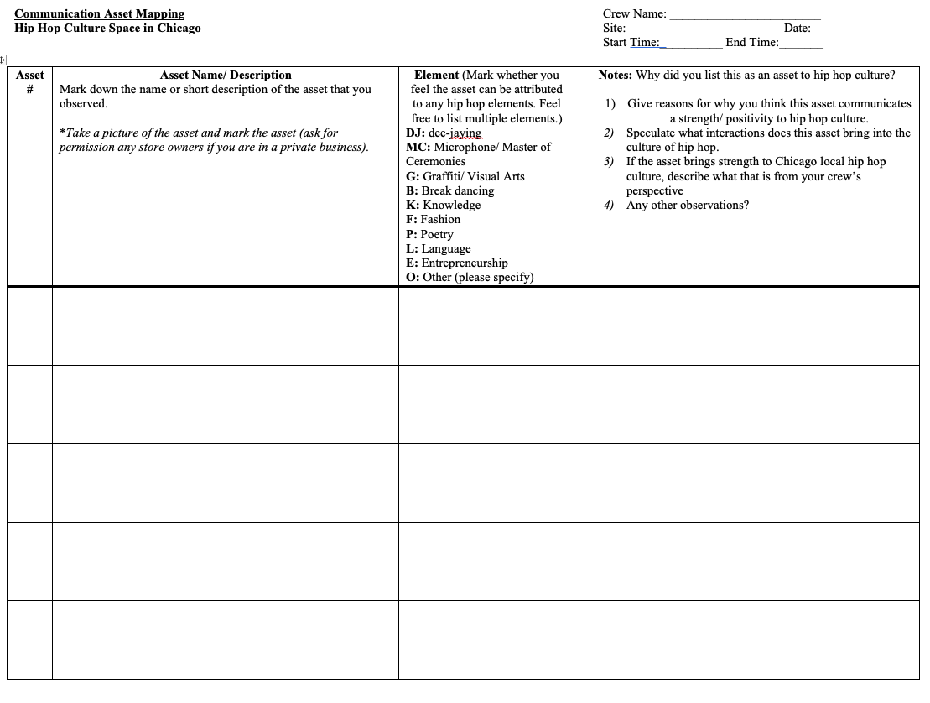
‘Communication Asset Mapping’ Hip Hop Culture
Community Building in Chicago
Focus on Teaching & Learning 2020
Project Goal: In four previously formed crews, students use a CAM mapping form to go to four assigned field sites in Chicago to observe and map out any communication assets they believe communicate community building in Chicago’s hip hop culture. The form guides their observation and documentation:
Asset Name/ Description/ Picture
Hip Hop Element Attribution
Notes that document why they listed their field observation as a communication asset to hip hop culture and community building

Slide 39
Crew Formations (group work)
Focus on Teaching & Learning 2020
Four crews of 4-5 students
Students name their crews like hip hop crews (inspirations – Wu Tang Clan, Tribe Called Quest, Odd Future, etc…)
Assigned four field sites in Chicago to explore hip hop culture communication asset mapping (physical sites to digital presence)
Give crews time in class and require crews to schedule dedicated time to do physical/ online fieldwork together
In class (synchronous online), require a 12-minute crew visual presentation of findings during fieldwork in class with 5 minute Q&A

Slide 40
Crew Formations & Assigned Field Sites
Focus on Teaching & Learning 2020
Gramaphone Records (DJ/ Turntabilism)
Young Chicago Authors Tuesday Wordplay (MC/ Spoken Word)
Project Logan Graffiti Wall (Graf writing)
Subterranean (Hip Hop Night, b-boy/ girl, MC, DJ)

Slide 41
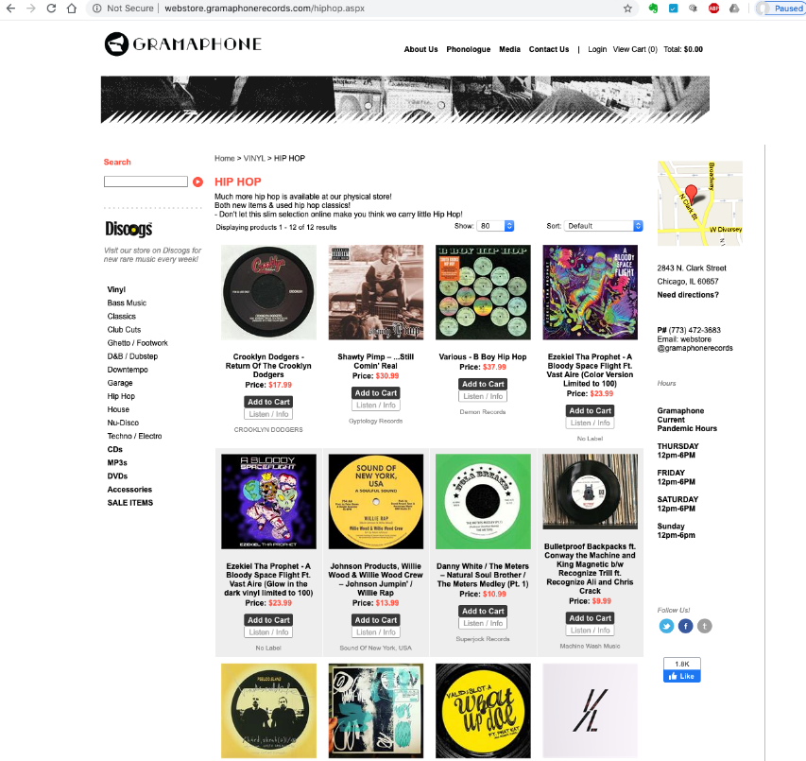
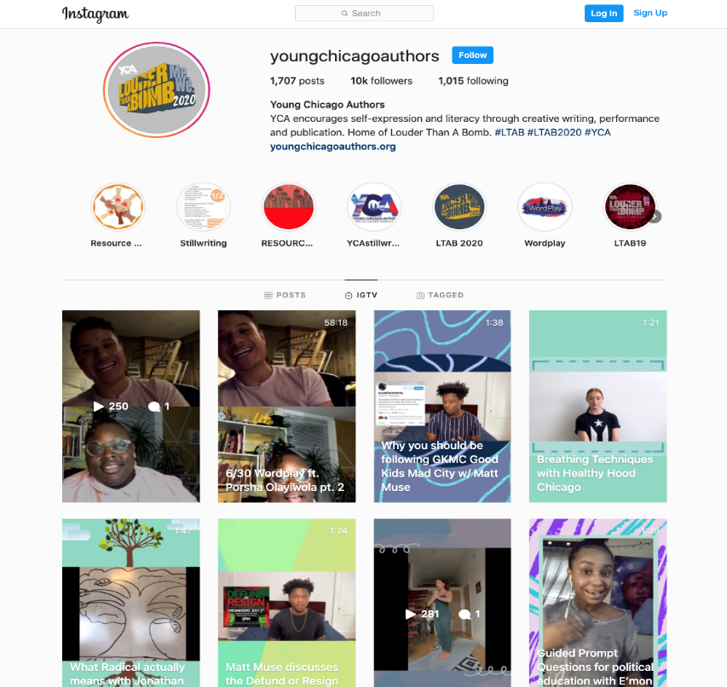
Adjusting to Online Community Fieldwork
Focus on Teaching & Learning 2020
Websites & Community Building
Social Media Presence & Community Building

Slide 42
Implications on Community Building
Focus on Teaching & Learning 2020
Physical hanging out in student crews transferred to primarily digital hanging out with crews
Tactile + sensual liveness of hip hop culture in physical place is not felt but interpreted through digital community presence
New appreciation for the physical George Floyd racial justice protests and how hip hop culture + Black and Brown placemaking in the streets and public spaces is vital for community building and social justice movements

Slide 43
References
Focus on Teaching & Learning 2020
Villanueva, G., Broad, G., Gonzalez, C., Ball-Rokeach, S., & Murphy, S. (2016). Communication asset mapping: An ecological field application toward building healthy communities. International Journal of Communication, 10, 2704-2724.
Villanueva, G. (2019). Chitown loves you: Hip hop’s alternative spatializing narratives and activism to Trump’s hateful campaign rhetoric about Chicago. Journal of Popular Music Studies, 31(2), 127–146.
Villanueva, G. (2020). You must learn: Sampling critical hip hop pedagogy in communication education spaces. Pedagogy, Culture and Society, 1-19.
Williams, A. D. 2009. “The Critical Cultural Cypher: Remaking Paulo Freire’s Cultural Circles Using Hip Hop Culture.” The International Journal of Critical Pedagogy 2 (1): 1–29.

